Slide 1
ASAM
Standards for Virtual Vehicle Testing
Dr. Klaus Estenfeld
Managing Director, ASAM e.V.

Slide 2
About ASAM
Who we are and what we do

Slide 3
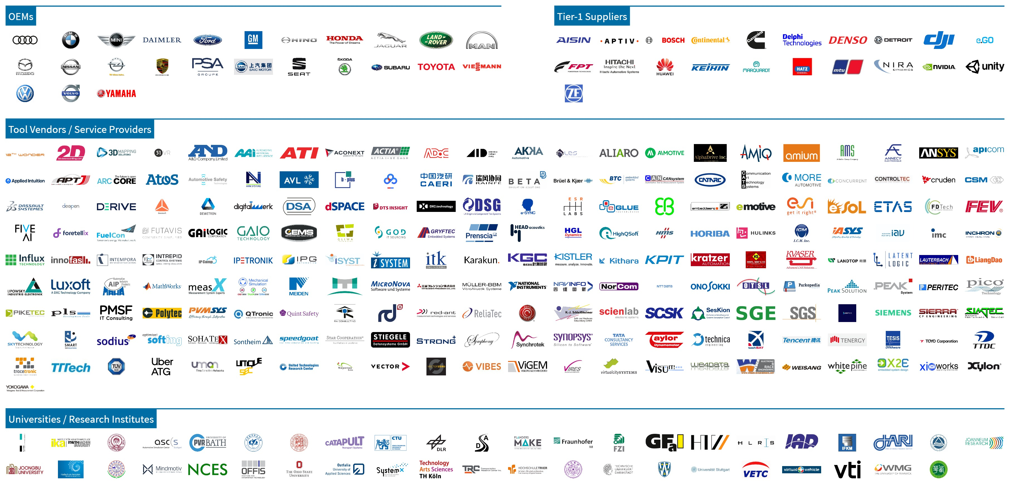
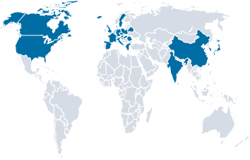
Who is ASAM e.V.
1998 Foundation of ASAM e.V.
~ 30 other members
ASAM Vision:
Currently more than 300 members from all over the world
We pursue the vision that tools of a development process chain can be freely interconnected and data can be seamlessly exchanged.
New ASAM Members since January 2019
EUROPE
+ 57
CHINA
NORTH AMERICA
+ 14
+ 12
JAPAN
+ 10
Rest of ASIA
+ 9

Slide 4
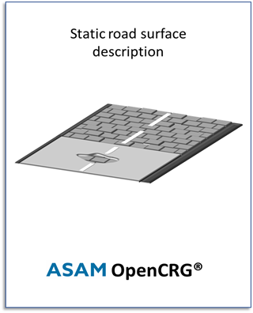
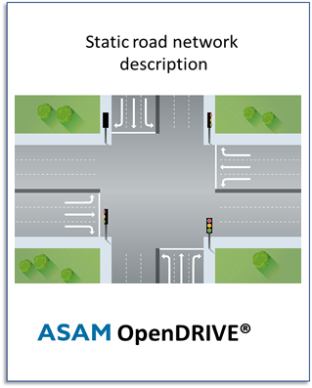
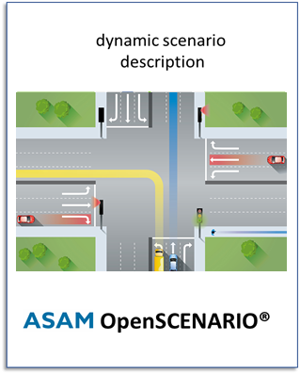
ASAM Standards Domains:
Measurement & Calibration
Simulation
Data Management & Analysis
Diagnostics
Start of the ASAM Simulation Domain
Transfer of OpenDRIVE to ASAM in Sept. 2018
ECU Networks
Test Automation
Software Development
OpenSCENARIO and OpenCRG followed in Nov. 2018

Slide 5
New Standardisation Initiatives in the Simulation Domain
ASAM OpenLABEL:
Object and scenario labelling format and labeling user guide
ASAM OSI: Open Simulation Interface
Generic interface between sensor models & ground truth
ASAM OpenXOntology:
Extendable domain ontology for the ASAM simulation domain
ASAM OpenODD:
Operational Design Domain: description format for HAD

Slide 6
ASAM OpenSCENARIO
2 Projects in the proposal phase (estimated start early June)
1.x
Further develop V1.0.0
More features
Usability improvements
More documentation
Proposal Link
2.0
Develop the concepts from the concept project
Domain Specific Language (DSL)
Framework for measurement and success criteria
Domain Model (UML or Ontology)
Proposal Link

Slide 7
ASAM OSI
Proposal phase (estimated start early June)
Open source development (contributions from non-members allowed)
4 Working Groups:
Physical sensor modeling
Representation of traffic participants & infrastructure
Harmonisation with OpenX
Performance & packaging
Proposal Link

Slide 8
ASAM OpenLABEL
Concept Project started April 2020 (runtime 6 months)
> 40 companies participating
Focus on the HOW to label → Provide labeling formats that can be linked to e.g. an ontology for the WHAT
Allow for labels of objects of interest & scenarios
2 deliverables:
Concept paper for OpenLABEL
List of requirements for the ASAM OpenXOntology project

Slide 9
ASAM OpenXOntology
Proposal phase (estimated start early June)
Domain Ontology: Definition of domain relevant terms and the possible relationships between them
Goal: Link OpenX standards through a common ontology → increased inter-compatibility
Deliverables:
Core ontology for ASAM OpenX domain
Guidelines on integration into current and existing standards
Migration/phasing examples for each OpenX standard
Document containing guidelines on extension of the ontology
Proposal link

Slide 10
ASAM OpenODD
Proposal phase (estimated start August)
Ideation Workshop end of April 2020
High interest 100 Participants
Standardized format for definition of Operational Design Domains (ODDs)

Slide 11
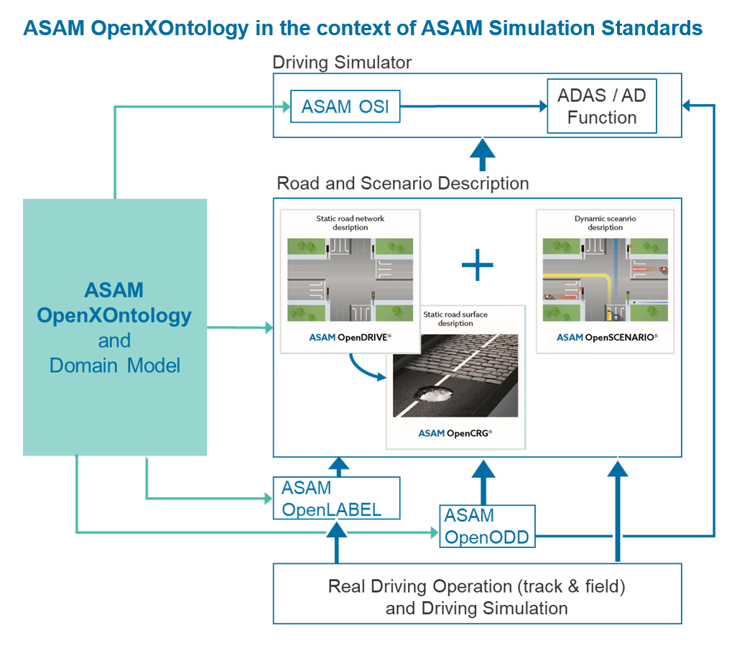
ASAM OpenX: Overview

Slide 12
Timeline 2020 / 2021
ASAM OpenDRIVE
ASAM OpenCRG
ASAM OpenSCENARIO
ASAM OSI
ASAM OpenLABEL
ASAM OpenXOntology
ASAM ODD
Whitespot Analysis: Test Case Description
3D Modelling & Material Data
Dec | Jan | Feb | Mar | Apr | May | Jun | Jul | Aug | Sep | Oct | Nov | Dec | Jan | Feb | Mar | Apr | May
V1.6.0
Next standard development
Concept project
Further development
V1.0.0
Further development: V1.x
Concept project
Further development: V2.0
Further development project
Concept project
New standard development
New standard or concept development
New standard or concept development
Whitespot analysis
New standard development
ASAM International Conference 2019
Releases: ASAM OpenDRIVE 1.6.0 ASAM OpenSCENARIO V1.0.0 ASAM OpenSCENARIO Concept
Releases: ASAM OpenCRG ASAM OpenLABEL Concept ASAM OpenDRIVE Concept

Slide 13
Thank you for your attention!
Dr. Klaus Estenfeld
ASAM e.V.
Phone: +49 151 64631204
Email: klaus.estenfeld@asam.net

